Slide 1
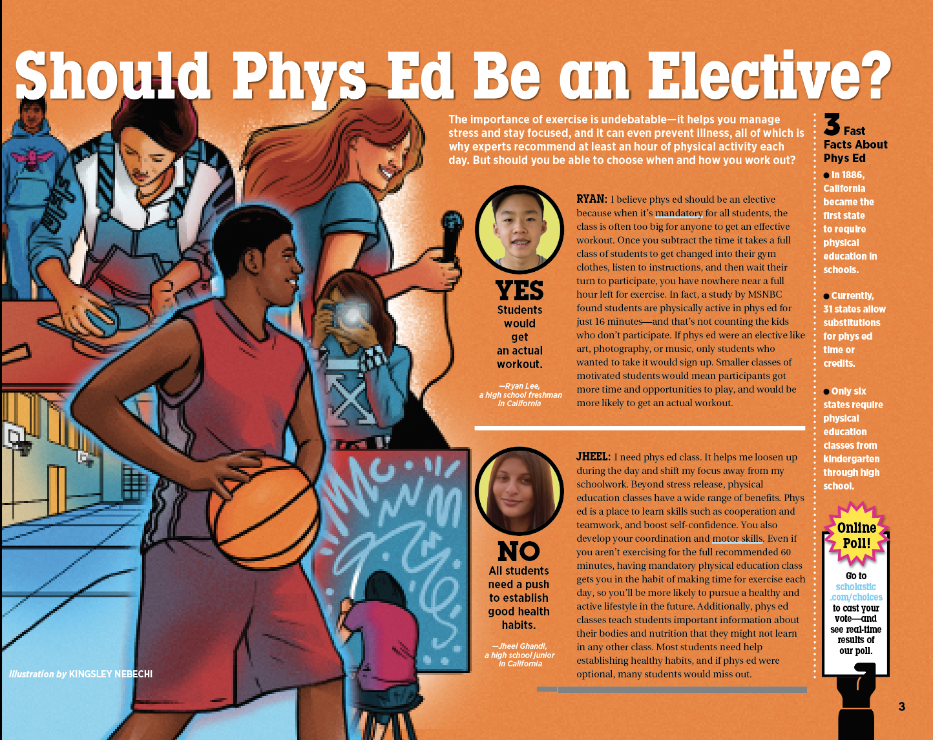

Slide 2
Read the debate. As you read, think about the questions below, then come back here and go to the next slide.

