Slide 1
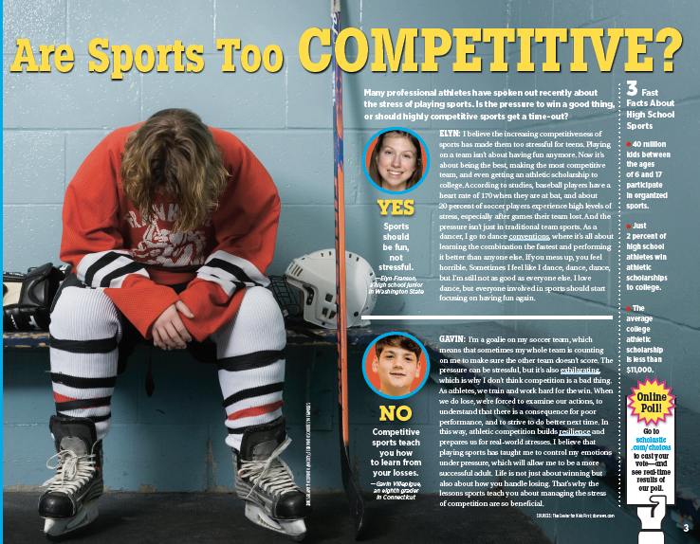

Slide 2


Slide 3
Read the debate. As you read, think about the questions below. Once you're done reading, move on to the next slide.

